Slide 1

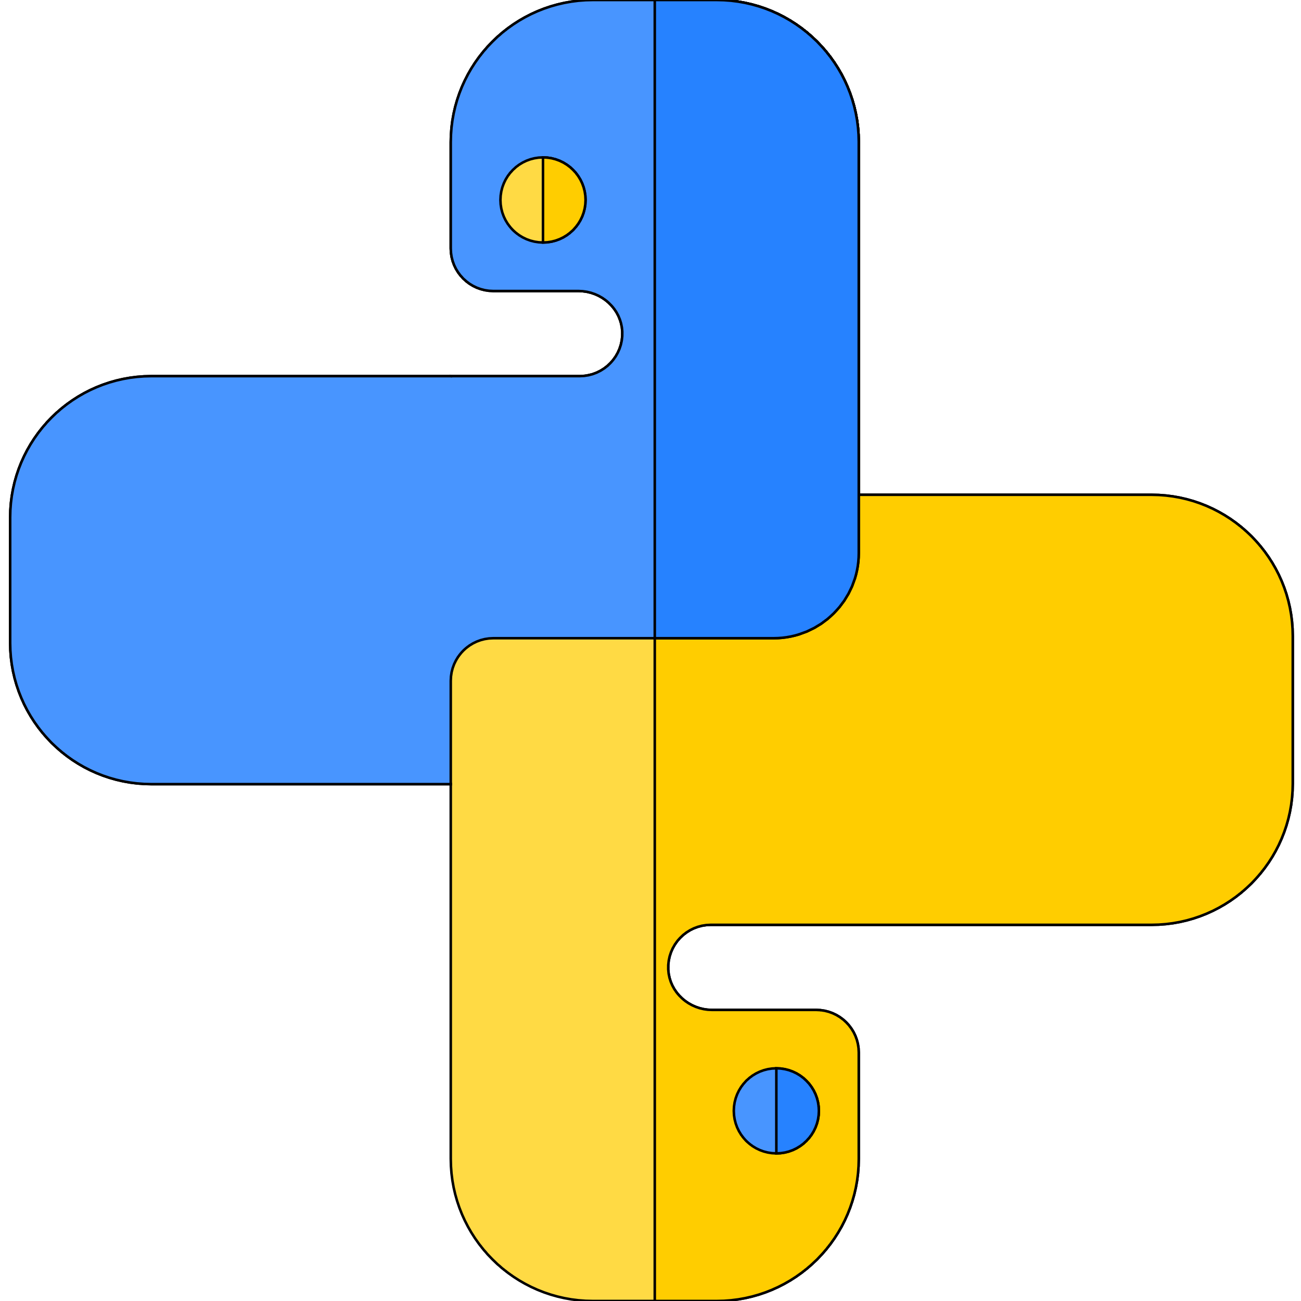


Lists in python
Author : Aman Singh
Lecture 10

Slide 2
Today’s Agenda
What is list?
Operations on Lists
List Methods

Slide 3


lists
?
Let’s start…

Slide 4
Lists…
List are mutable sequence of objects of any type.
Typically used to store homogeneous items.
Comparing to strings lists are mutable objects of any type whereas strings are immutable objects of only character type.
We can change values of lists after creating them.
We can perform all slicing operations like other sequence.
we can concatenate two lists using + operator.

Slide 5
List Methods
Reverse() # it will arrange elements of list in reverse order.
List methods are called in-place methods, they modify the original list.
Sort() #sort elements alphabetically
Sorted()# returns a new sorted object
Len()
pop() #take out last element and return.
Insert(position, object) #insert object to specific location.
List.remove(object) remove a specific object.

Slide 6

Thanks!
Any questions?
Just Comment down below.
If you like this video don’t forget to Subscribe and Share
You can find me at singhaman11415@gmail.com

